Slide 1
Session 2: Shell and Shell Scripting

Slide 2

01
Introduction to Shell & Types
02
Basic Shell Commands
Session Agenda
03
Writing Shell Scripts
04
Conditionals and Loops
05
Lab Exercises and Demos

Slide 3

A shell is a program that interprets commands from the user to the operating system. It enables interaction with system services via command-line or scripts. The shell acts as a bridge between the user and the Linux kernel.
What is a Shell?
Understanding the Shell Interface

Slide 4

Popular shell types include Bourne Shell (sh), Bourne Again Shell (bash), C Shell (csh), Korn Shell (ksh), and Z Shell (zsh). Bash is the most commonly used shell today.
Types of Shells
Different Shell Environments in Linux

Slide 5

Shell Scripting Basics
Definition
Shell scripting involves writing a sequence of commands in a file for the shell to execute. It's commonly used for automating repetitive tasks.
Structure
A typical shell script starts with a shebang (`#!/bin/bash`), followed by commands and logic using conditionals or loops.
Execution
Make the script executable with `chmod +x filename.sh`, then run it using `./filename.sh`.

Slide 6

This simple script prints 'Hello World' to the terminal. Begin with `#!/bin/bash`, followed by `echo "Hello World"`. Save it as `hello.sh`, make it executable, then run it.
Hello World: First Script
Writing Your First Shell Script

Slide 7
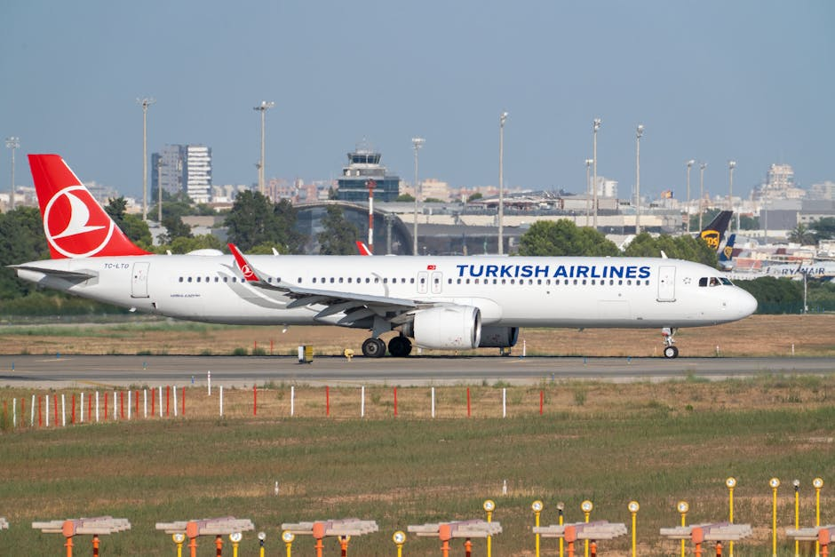
Shell Commands: Navigation
pwd & cd
`pwd` shows your current directory. `cd` changes directory. Use `cd ..` to move up one level.
ls & tree
`ls` lists contents in a directory. `tree` shows directory structure (may require installation).
Use Case
Navigating filesystems is essential before scripting. Practice listing, switching, and locating files.

Slide 8

Shell Commands: File Handling
Creating & Removing Files
Use `touch filename` to create a file. `rm filename` deletes it. Use with caution!
Moving & Copying
`mv source target` moves/renames files. `cp source target` copies them.
Directory Operations
`mkdir` creates directories. `rmdir` removes empty ones. Use `rm -r` cautiously for folders.

Slide 9

Conditionals: if & if-else
Basic 'if' Syntax
Use `if [ condition ]; then ... fi` to check and run commands if true. Always maintain spacing and semicolon.
Adding 'else'
Use `else` to handle false conditions. It follows the `if` block and provides alternate execution.
Example Use
Check if a file exists: `if [ -f file.txt ]; then echo "Exists"; else echo "Missing"; fi`.

Slide 10

Advanced Conditionals: elif
Using elif
`elif` allows checking multiple conditions sequentially. Combine with `if` and `else` for full logic control.
Syntax Structure
if [ cond1 ]; then ... elif [ cond2 ]; then ... else ... fi
Example
Test number range: `if [ $num -lt 0 ]; then ... elif [ $num -eq 0 ]; then ... else ... fi`

Slide 11

Loops in Shell: for
for Loop Structure
Use `for var in list; do ... done` to repeat a block for each item in a list. Great for file operations or batch processing.
Example
`for file in *.txt; do echo $file; done` prints each text file name.
Real Use Cases
Use to iterate over arguments, filenames, or numeric sequences.

Slide 12

Loops in Shell: while & until
while Loop
Repeats as long as a condition is true. Useful for waiting on system states or user input.
until Loop
Repeats until a condition becomes true (opposite of `while`).
Example
`while [ $x -lt 5 ]; do echo $x; ((x++)); done` increments x until 5.

Slide 13
Lab Activity Overview
Script 1: Hello World
Script 2: Conditionals
Script 3: Loops
Create a simple shell script that prints a message and current directory.
Write a script to check if a file exists using if-else or if-elif-else.
Use for/while/until loops to iterate through a list of items or repeat a message.

Slide 14

How to execute the demo script?
What output should be expected?
Navigate to your script’s folder, make it executable with `chmod +x`, then run using `./script.sh`.
Output should reflect input logic—use echo statements to print progress or condition results.

Slide 15
Summary
What are 3 key takeaways from today?
Session Recap & Quiz
1. Shell scripts automate tasks using commands, conditionals, and loops. 2. Practice using bash, navigation commands, and file handling. 3. Use scripting for efficiency, especially in repetitive system operations.

